Slide 1
XGBoost-Driven Insights Enhancing Chronic Kidney Disease Detection

Slide 2
Abstract
This project focuses on developing a Chronic Kidney Disease (CKD) Detection System using XGBoost, a robust machine learning algorithm that enhances diagnostic accuracy. The system analyzes patient data, such as serum creatinine levels, blood pressure, age, and specific medical markers, to predict the likelihood of CKD. By leveraging the power of XGBoost, the model achieves high accuracy, precision, and recall rates, ensuring minimal false negatives or positives. Designed for real-time predictions, this system can be easily integrated into healthcare environments, helping clinicians make timely, data-driven decisions. Ultimately, this project aims to improve early detection, patient management, and overall healthcare outcomes for individuals suffering from kidney-related diseases.

Slide 3
Introduction
This project focuses on the development of a Chronic Kidney Disease (CKD) Detection System using XGBoost, a powerful machine learning algorithm. The system analyzes various patient medical data, such as serum creatinine, blood pressure, and age, to predict the risk of CKD. By leveraging advanced machine learning techniques, it aims to provide healthcare professionals with a reliable tool for early diagnosis and timely intervention. The model is designed for real-time predictions, ensuring efficient and accurate decision-making. This project’s goal is to improve CKD detection, reducing the burden on healthcare systems and enhancing patient outcomes.

Slide 4
Existing System
The existing systems for Chronic Kidney Disease (CKD) detection primarily rely on traditional methods such as blood tests, urinalysis, and manual evaluations by healthcare professionals. These methods often involve lengthy processes and may result in delays in diagnosis. Some machine learning models have been applied, but many of them lack the required accuracy and efficiency for clinical use. Additionally, these systems may struggle with handling large datasets or providing real-time predictions. There is a need for a more accurate, scalable, and efficient solution for early CKD detection, which this project aims to address.

Slide 5
Proposed System
The proposed CKD Detection System utilizes the XGBoost machine learning algorithm to accurately predict the risk of chronic kidney disease based on patient data such as serum creatinine, blood pressure, and age. This system offers real-time predictions, significantly reducing diagnostic delays and assisting healthcare professionals in timely decision-making. It is designed to handle large datasets efficiently, ensuring scalability and accuracy. By automating the prediction process, it minimizes human error and provides a more reliable, data-driven approach to early CKD detection. This system aims to enhance patient outcomes and improve overall healthcare efficiency.

Slide 6
LITERATURE REVIEW
The literature on Chronic Kidney Disease (CKD) detection highlights the growing use of machine learning techniques for improving diagnostic accuracy and early detection. Several studies have explored traditional methods like blood tests and urinalysis, but they often face limitations in speed and efficiency. Recent research focuses on applying algorithms like decision trees, SVM, and XGBoost to predict CKD, showing promising results in classification accuracy. However, most models still struggle with scalability and real-time predictions. This project builds on these findings, utilizing XGBoost to enhance prediction reliability and processing speed for clinical use.

Slide 7
Modules:
Data Preprocessing – This module involves cleaning and preparing the dataset by handling missing values, scaling numerical features, and encoding categorical variables to ensure the data is ready for model training.
Feature Extraction & Classification – In this step, key features such as serum creatinine, blood pressure, and age are extracted and used for classification. XGBoost is then applied to predict CKD risk based on these features.
RGB Composite & Band Selection – For enhanced data representation, this module uses RGB composite images to visualize multi-dimensional data and selects relevant bands for more accurate model input, improving feature quality.
Interactive Visualization – This module provides real-time, interactive visualizations of patient data and model predictions, enabling healthcare professionals to better understand and interpret the results.
Model Deployment & Performance Analysis – After training, the model is deployed for real-time predictions. Performance metrics like accuracy, precision, and recall are analyzed to ensure the system's effectiveness and reliability in detecting CKD.

Slide 8
Algorithms Used:
Convolutional Neural Networks (CNNs) – Although traditionally used for image data, CNNs can also capture spatial hierarchies in medical data. In this project, CNNs help extract complex patterns from patient data that may indicate CKD risk, aiding in feature learning.
Principal Component Analysis (PCA) – PCA is used for dimensionality reduction, simplifying large datasets while retaining the most important features. This technique helps reduce computational complexity, making the model more efficient without sacrificing prediction quality.
Softmax Classifier – The Softmax function is used in the final layer of the model to convert the raw output of the network into a probability distribution, ensuring the accurate classification of CKD into different risk categories.
Data Augmentation Techniques – Data augmentation is used to artificially expand the dataset by generating new, diverse examples through transformations like scaling, rotating, or flipping. This helps improve the model’s robustness and generalization.
Adam Optimizer & Cross-Entropy Loss – The Adam optimizer is utilized for efficient weight updates during training, ensuring fast convergence. Cross-entropy loss is applied as the loss function to measure the difference between predicted probabilities and actual outcomes, optimizing the model’s performance.

Slide 9
Software Components:
Programming Language: The project is developed using Python, a versatile programming language widely used for machine learning and data analysis tasks due to its rich ecosystem of libraries and frameworks.
Frameworks & Libraries:
TensorFlow/Keras or PyTorch: These deep learning frameworks are used for building and training neural network models, particularly helpful for tasks such as feature extraction, classification, and model optimization.
OpenCV: A crucial library for computer vision tasks, OpenCV is used for processing and analyzing visual data, including images or video feeds, if incorporated into the system for real-time CKD detection.
Scikit-learn: A popular library for machine learning, Scikit-learn is used for implementing traditional algorithms, preprocessing, and evaluating the performance of models like XGBoost.
Pandas & NumPy: These libraries are used for efficient data manipulation, preprocessing, and handling large datasets. Pandas provides easy-to-use data structures, while NumPy allows for efficient numerical calculations.
Matplotlib & Seaborn: These visualization libraries are employed to create various graphs, charts, and plots for data analysis, model evaluation, and displaying the performance metrics of the CKD detection system.
Streamlit: Streamlit is used to develop an interactive web application for model deployment, allowing real-time predictions and providing an easy-to-use interface for healthcare professionals.
Hardware Components:
Processor: A multi-core processor such as Intel i7/i9 or AMD Ryzen is ideal for efficiently running data processing and machine learning algorithms, ensuring smooth execution of training and inference tasks.
RAM: A minimum of 16 GB RAM is recommended to handle large datasets, particularly for training deep learning models. Higher memory ensures faster data processing and model training.
Storage: 1 TB SSD storage is recommended for quick data access and efficient storage of large datasets, model weights, and outputs.
GPU (Highly Recommended): A NVIDIA GPU (such as RTX 3080 or Tesla V100) is highly recommended for accelerated deep learning model training and processing. GPUs provide significant performance improvements for computationally intensive tasks like neural network training.
Cloud GPU (Optional for Deployment): For scalable deployment, cloud-based GPUs such as Google Cloud AI, AWS EC2 with GPU, or Microsoft Azure GPU can be utilized, offering flexibility in terms of scaling, resources, and accessibility for large-scale predictions.

Slide 10
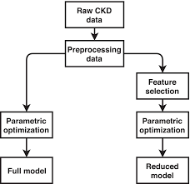
Block Diagram

Slide 11
UML Diagrams
Use Case Diagram
Data Flow Diagram
Sequence Diagram
State Diagram

Slide 12
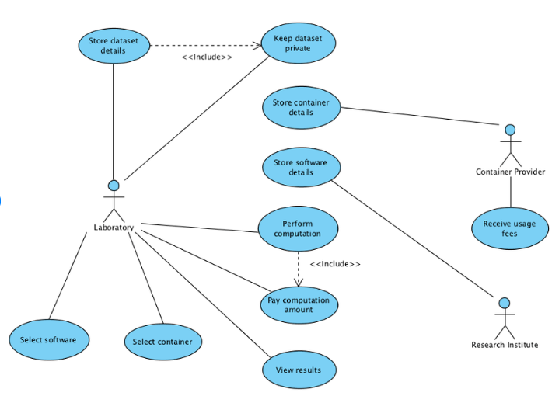
Use case Diagrams

Slide 13
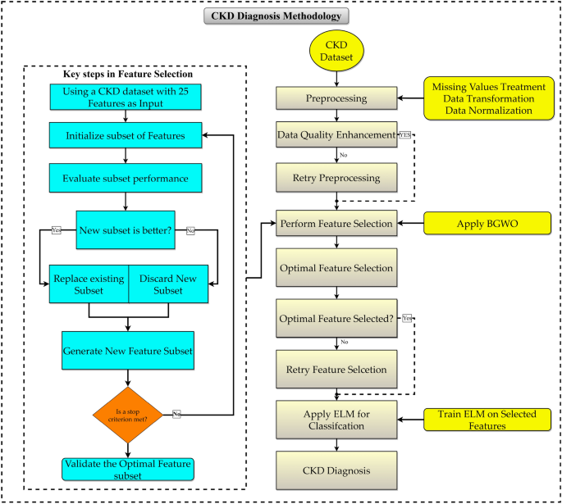
Data Flow Diagrams

Slide 14
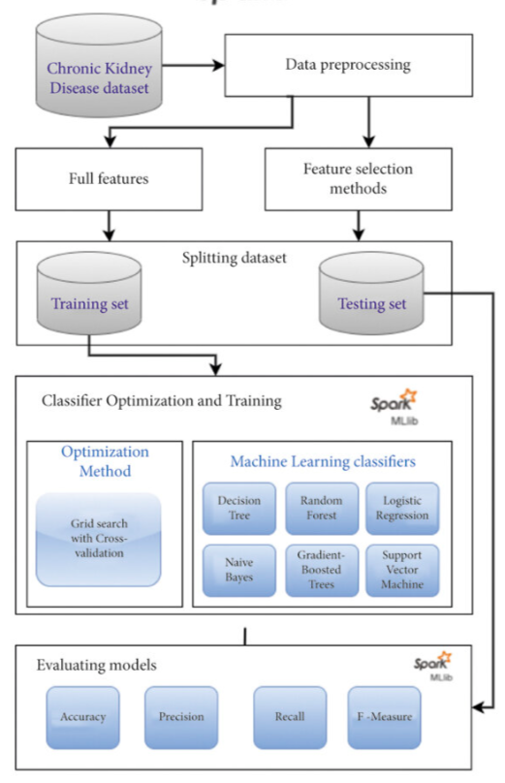
Sequance Diagrams

Slide 15
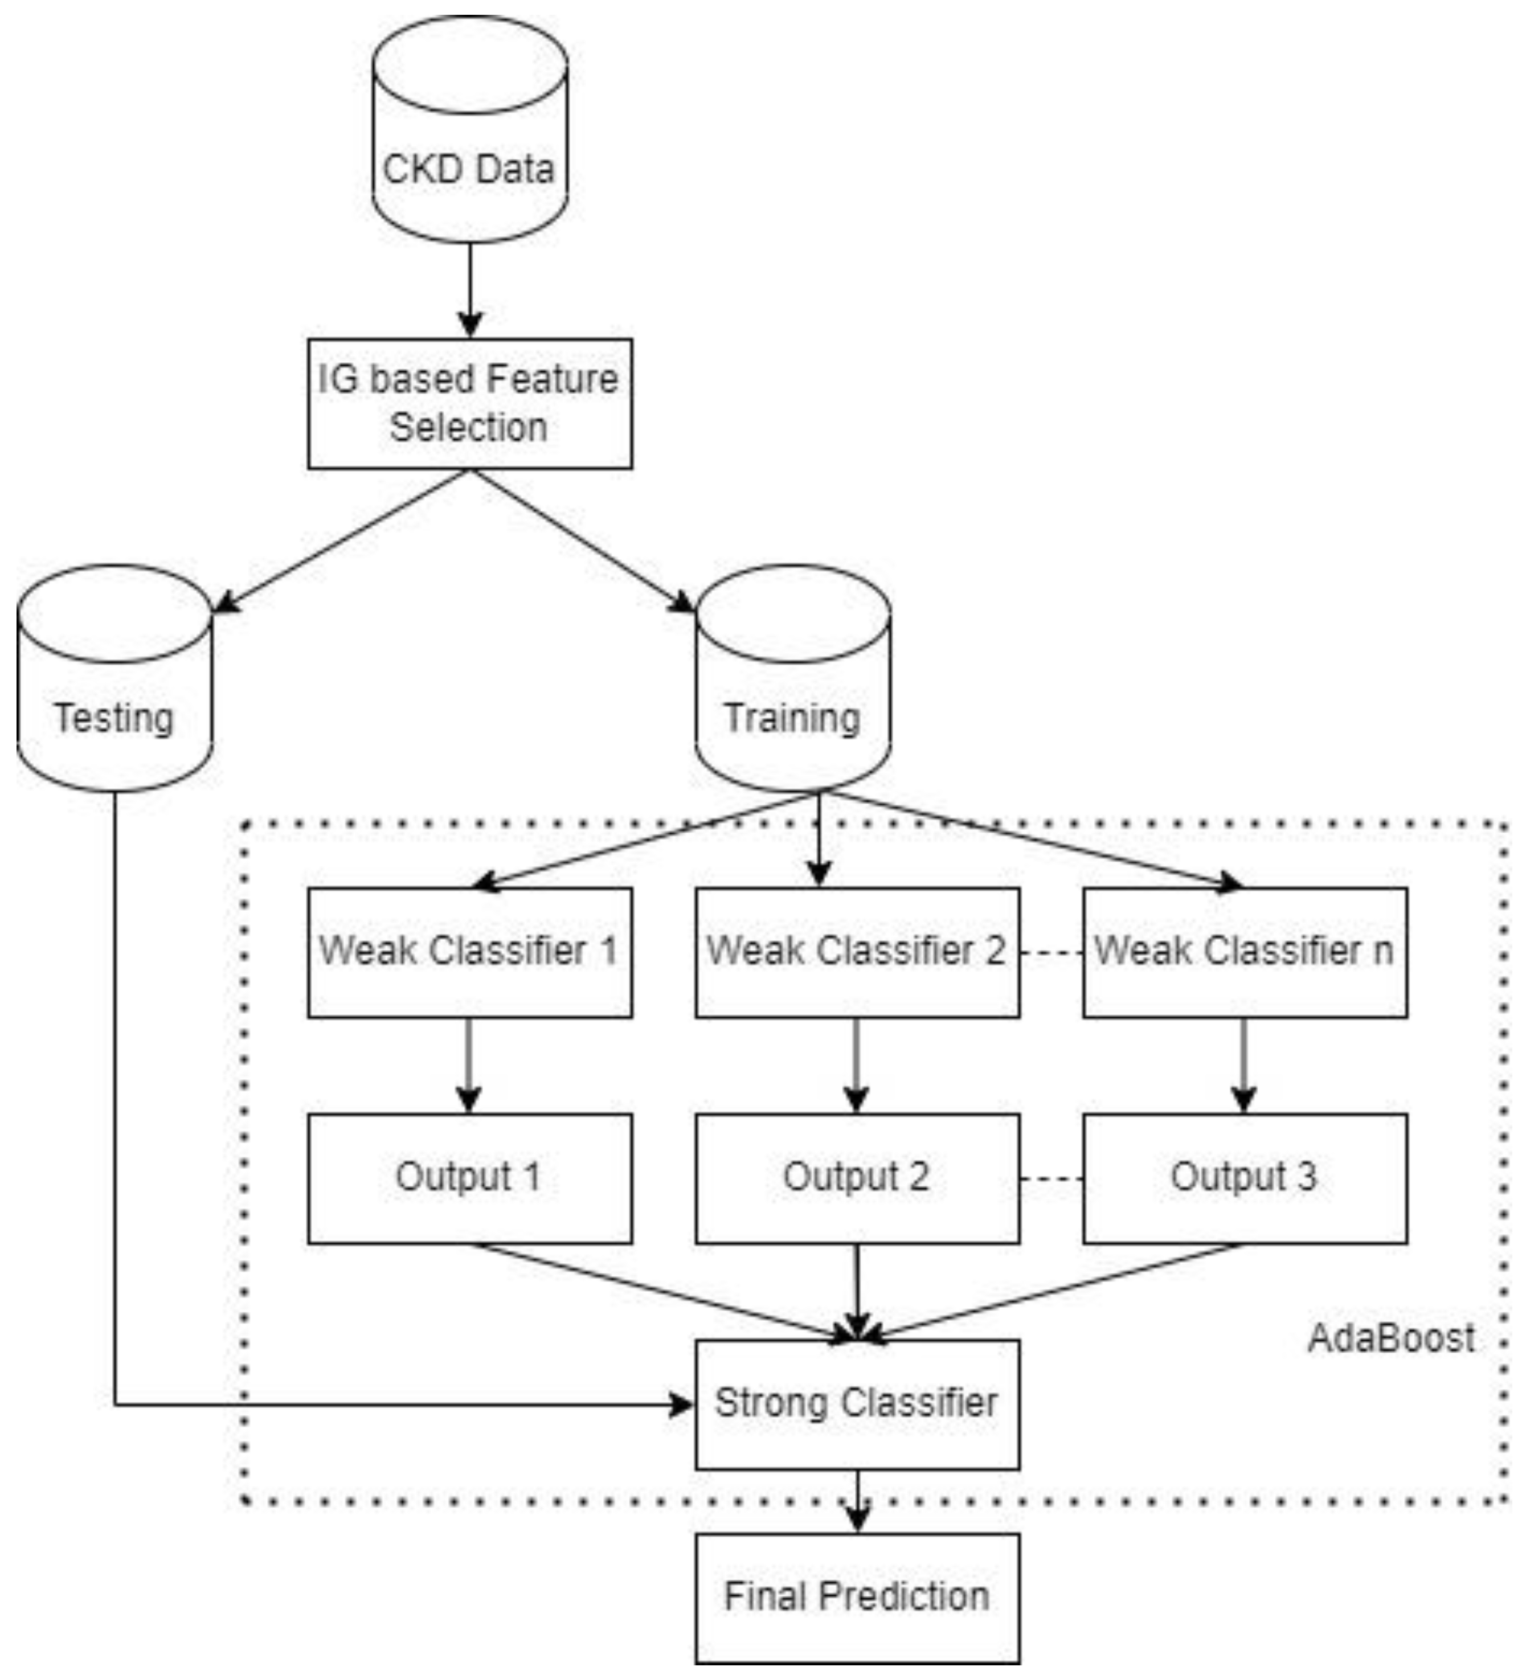
Active Diagrams

Slide 16
Final Output
The final output of the Chronic Kidney Disease (CKD) Detection System is a fully functional and efficient machine learning model capable of accurately predicting the risk of CKD in patients based on their medical data. By leveraging the power of XGBoost and advanced data preprocessing techniques, the system provides real-time predictions with high accuracy. The output includes detailed classification results, displaying the likelihood of CKD and risk factors associated with the patient’s health. The model is deployed via a user-friendly Streamlit interface, which allows healthcare professionals to input patient data and receive instant predictions. Additionally, performance metrics like accuracy, precision, recall, and F1-score are analyzed to ensure the model's effectiveness, ensuring it can reliably support clinical decision-making and improve patient outcomes.

Slide 17
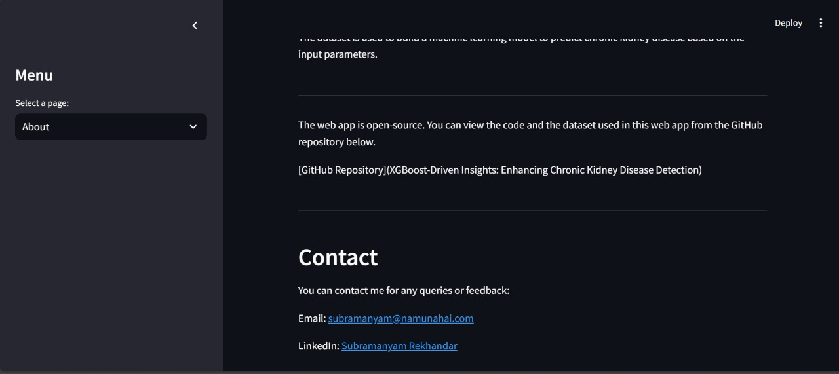
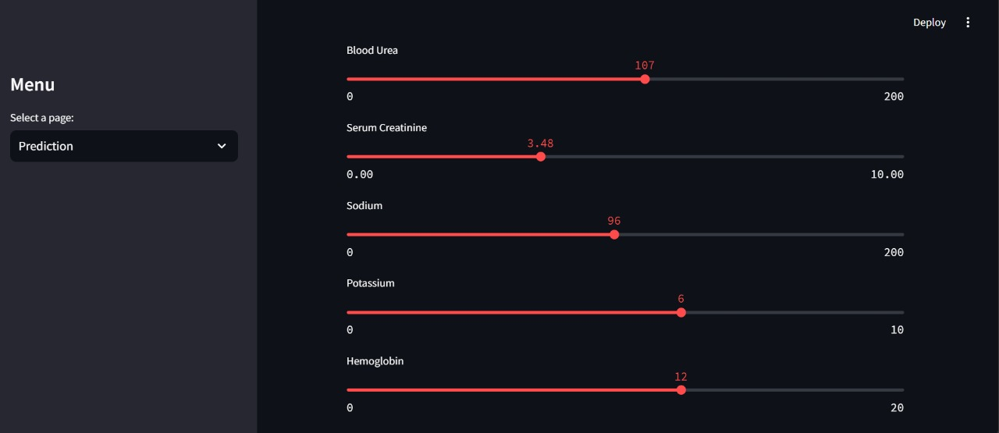
Final Output

Slide 18
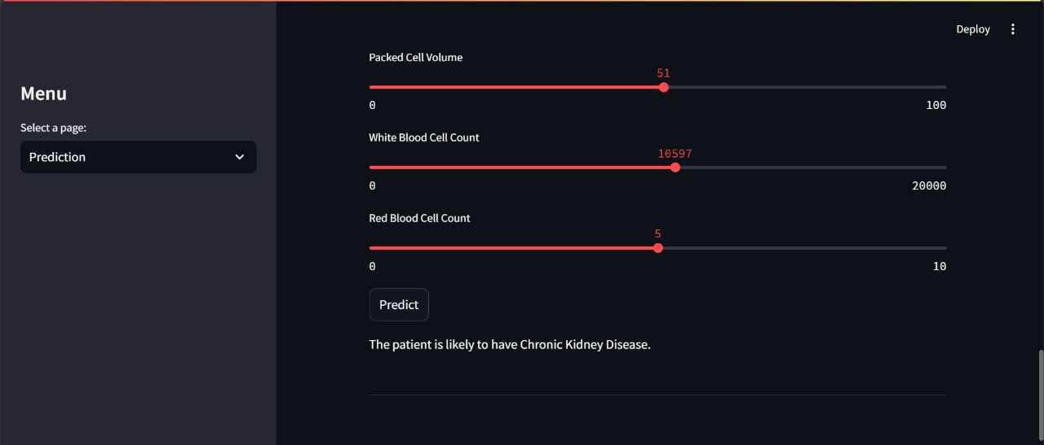
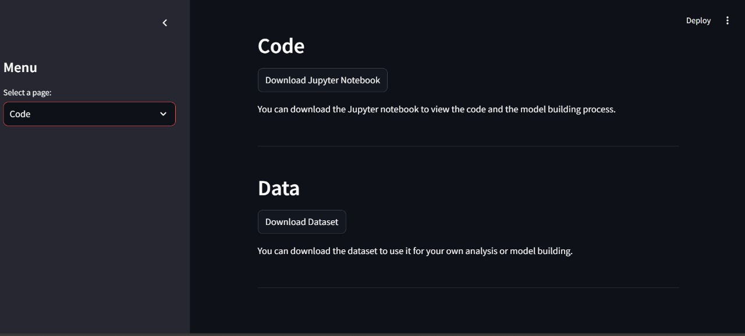
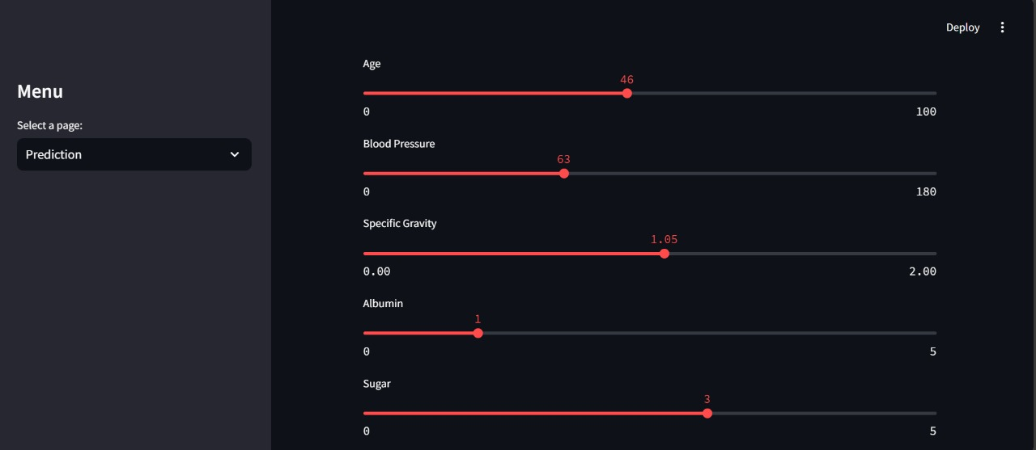
Final Output

Slide 19
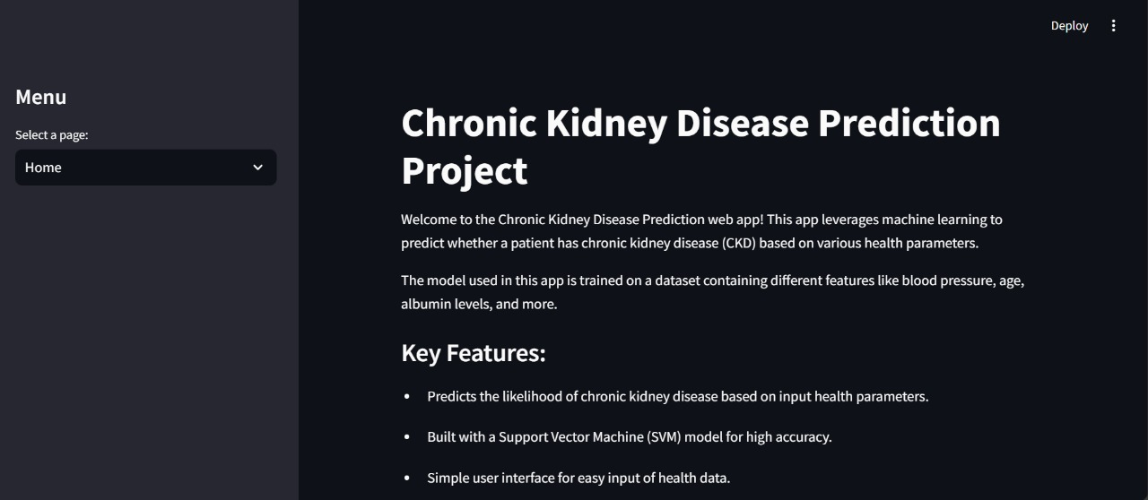
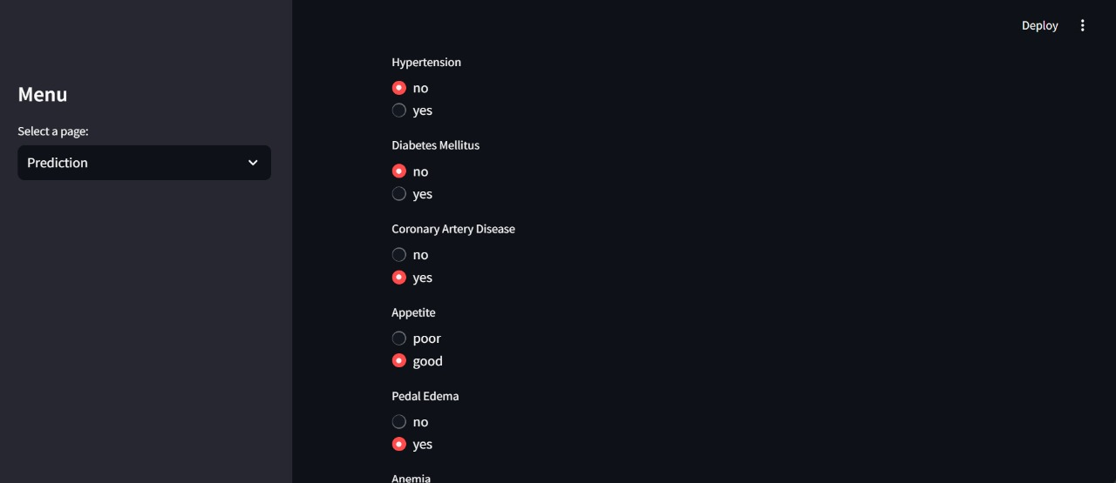
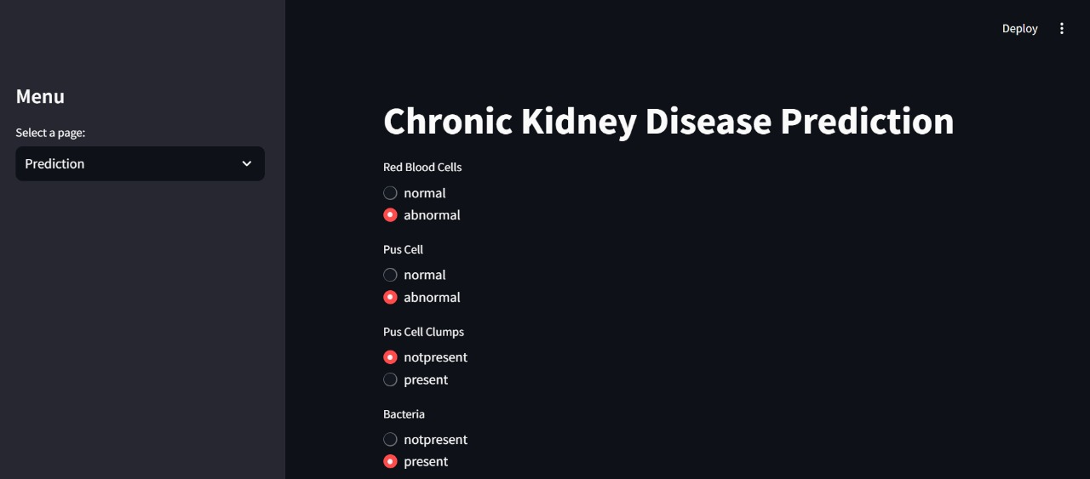
Final Output

Slide 20
Conclusion
In conclusion, the Chronic Kidney Disease (CKD) Detection System developed using the XGBoost algorithm provides an efficient, accurate, and scalable solution for early CKD diagnosis. By leveraging machine learning techniques and real-time data analysis, the system significantly enhances the predictive capabilities compared to traditional methods. The integration of a user-friendly interface ensures easy access for healthcare professionals, enabling timely intervention and improved patient care. This project highlights the potential of data-driven approaches in transforming healthcare, offering an innovative tool for early CKD detection and management. Moving forward, the system can be further optimized for larger datasets and expanded for use in diverse healthcare environments.

